Slide 1
Waslni

Slide 2
Waslni is a business platform between customers, commercial activities and even non-commercial (services), as it provides an extensive network of leading service providers. It provides knowledge of the best place through the evaluation of previous visitors, as well as knowledge of who provides quality services and reasonable prices.

Slide 3
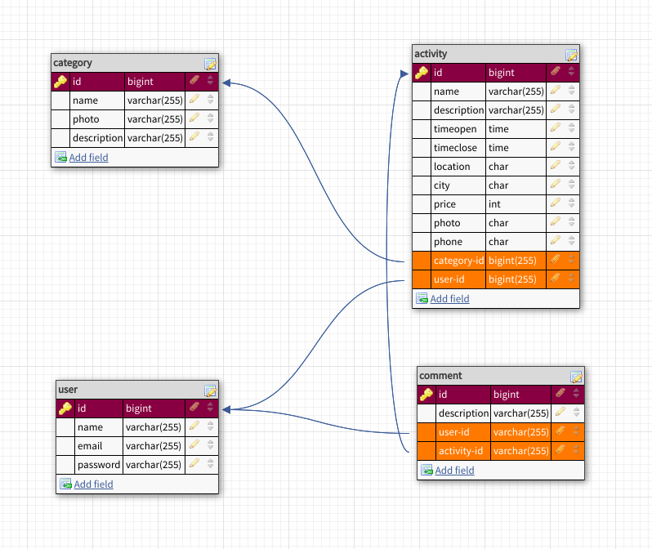
Database Design

Slide 4
Relationships
One To Many=>between Category & Activities.
One To Many=>between User & Activities.
One To Many=>between User & Comments.
One To Many=>between Activity & Comments.

Slide 5
Yasmin alhajjaj
thanks

